Slide 1

Amazon Prime and TV Shows Data Analysis and Dashboard
By:
Latifa Aulia Esmananda - latifaesmananda@gmail.com

Slide 2
Table of contents
01
03
02
04
Dataset
Enhance & Analyze Data
Data Cleaning
Visualizations & Dashboard

Slide 3
01
Dataset

Slide 4
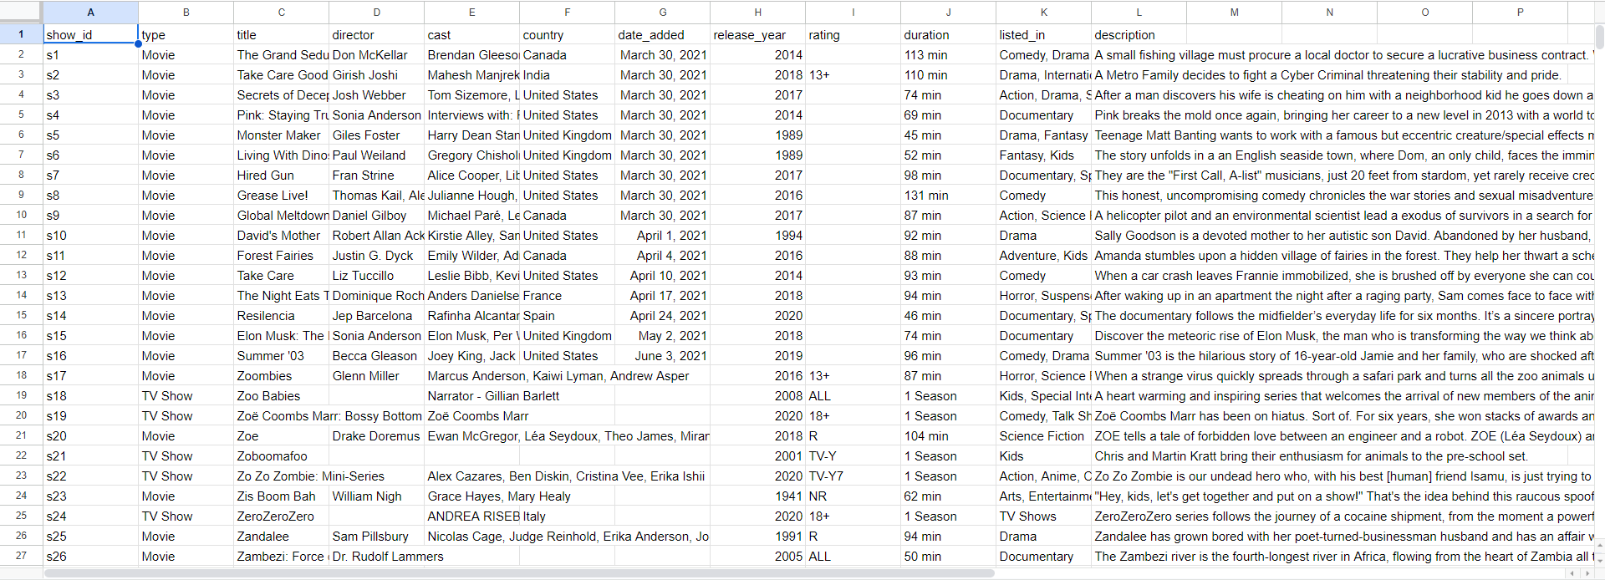
Sneapeek of Dataset
Source:
Kaggle

Slide 5
02
Data Cleaning

Slide 6
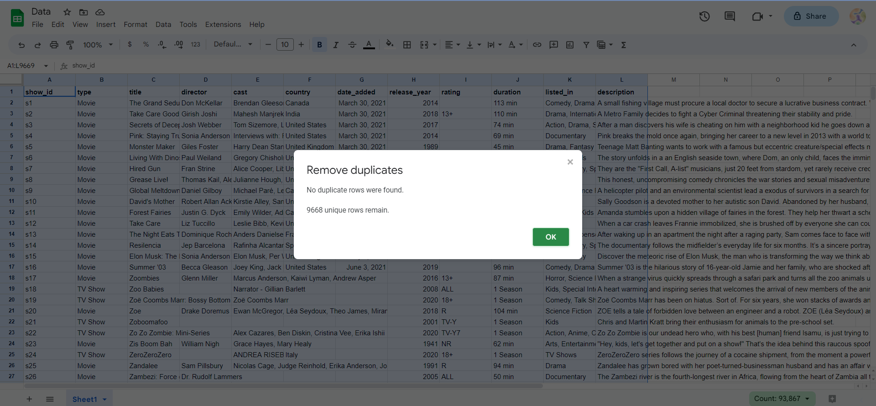
Remove Duplicate Data

Slide 7
There is no duplicate data, so nothing will be dropped. So, after checking the duplicate rows, we will still have 9668 rows.

Slide 8
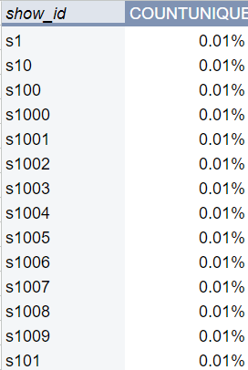

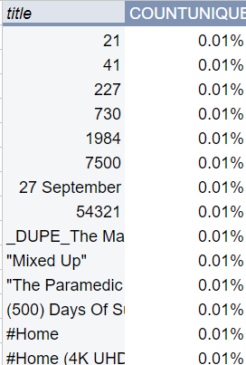
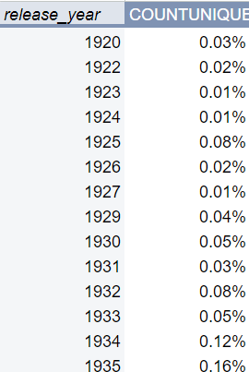
Handle Missing Value
Check missing data (null value) for all of the column. If any, handle it.
For column ‘show_id’, ‘type’, ‘title’, ‘release_year’ have no missing value.

Slide 9
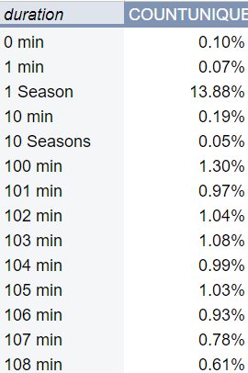
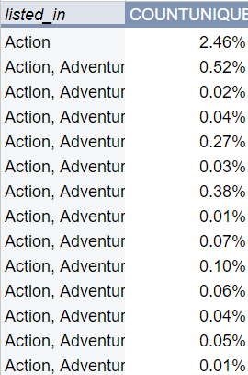
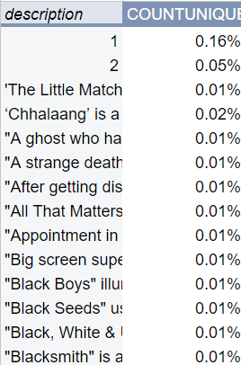
Handle Missing Value
Check missing data (null value) for all of the column. If any, handle it.
For column ‘duration’, ‘listed_in’, and ‘description’ have no missing value.

Slide 10
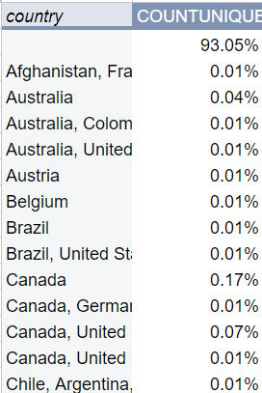
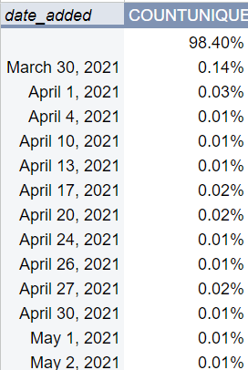
Handle Missing Value
Because column ‘country’ and ‘date_added’ have missing values more than 90% which is a large amount of percentage, this column will be excluded at the analysis.

Slide 11
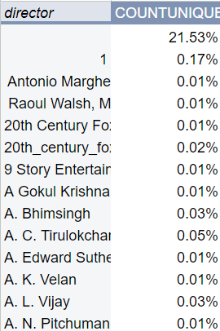
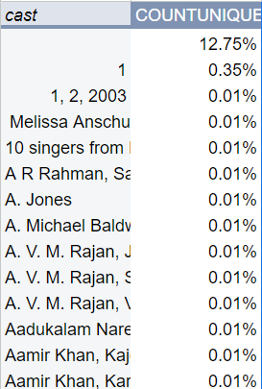
Handle Missing Value
Because column ‘director’ and ‘cast’ have missing values around 21% and 12%, missing values in this column will be replaced by ‘unidentified’ before the analysis.

Slide 12
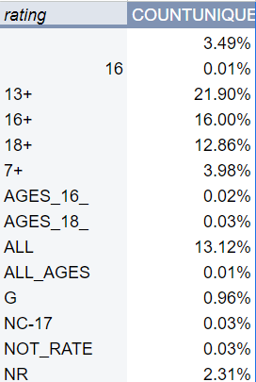
Handle Missing Value
Because column ‘rating’ have missing values around 3% that is less than 5%, missing values in this column will be deleted before the analysis.

Slide 13
03
Enhance & Analyze Data

Slide 14
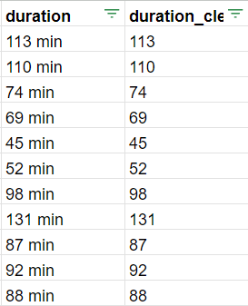
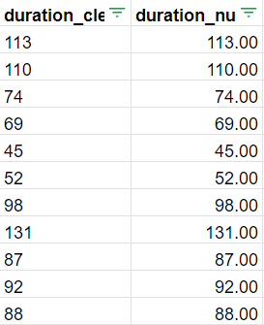
Enhance Data
Change ‘duration’ column to only have its values without text and have a number type of cell
Using REGEXEXTRACT(), we want to make the new column to only have the number of values from the ‘duration’ column.
Copy values of ‘duration_clean’ column into the new one. Convert the types of ‘duration_num’ column into number types.

Slide 15
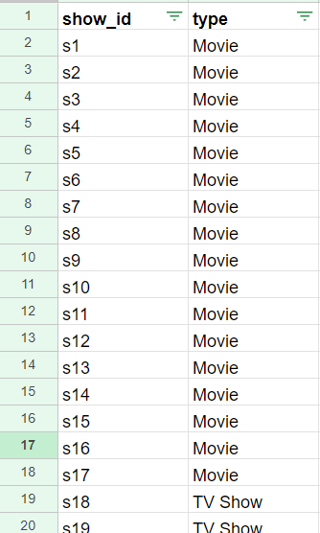
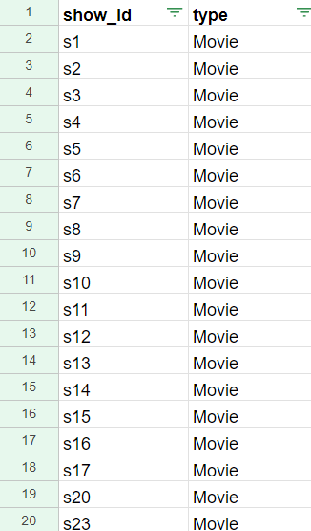
Enhance Data
Sort the data by the types of the shows for easily and clean look of the data.

Slide 16
Enhance Data
Grouping the value of ‘rating’ column by:
Group named ‘7+’ that consists of ‘7+’ and ‘TV-Y7’ values
-> only for aged 7 and above
Group named ‘13+’ that consists of ‘13+’ and ‘PG-13’ values
-> only for aged 13 and above
Group named ‘14+’ that consists of ‘TV-14’
-> only for aged 14 and above
Group named ‘16+’ that consists of ‘16’, ‘16+’ and ‘AGES_16’ values
-> only for aged 16 and above
Group named ‘17+’ that consists of ‘NC-17’, ‘R’, and ‘TV-MA’ values
-> only for aged 17 and above
Group named ‘18+’ that consists of ‘18+’ and ‘AGES_18_’ values
-> only for aged 18 and above
Group named ‘NOT_RATE’ that consists of ‘NR’, ‘NOT_RATE’, ‘UNRATED’ and ‘TV-NR’ values
-> for title that had not been rated
Group named ‘PG’ that consists of ‘TV-PG and ‘PG’ values
-> for title that need parental guidance
Group named ‘TV-Y’ that consists of ‘TV-Y’ values
-> for children of all ages
Group named ‘ALL’ that consists of ‘G’, ‘TV-G’, ‘ALL’ and ‘ALL_AGES’ values
-> for all ages

Slide 17
04
Visualizations & Dashboard

Slide 18
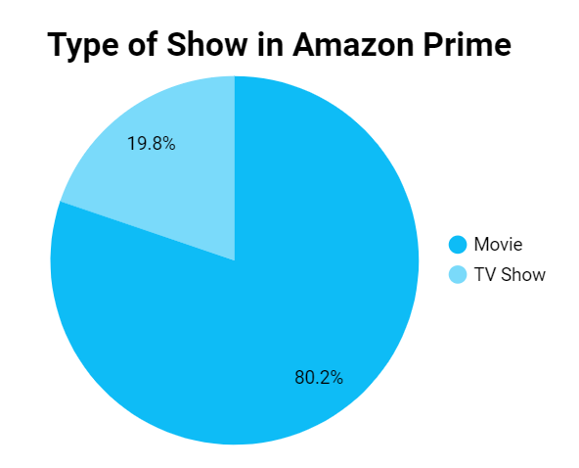
From the chart, we can see that around 80% of show in Amazon Prime is movies while the remaining is TV show. It can represents that movies are more likely to be watched and easily be added to Amazon Prime. Despite that, considering to add more type of TV show to Amazon Prime.

Slide 19
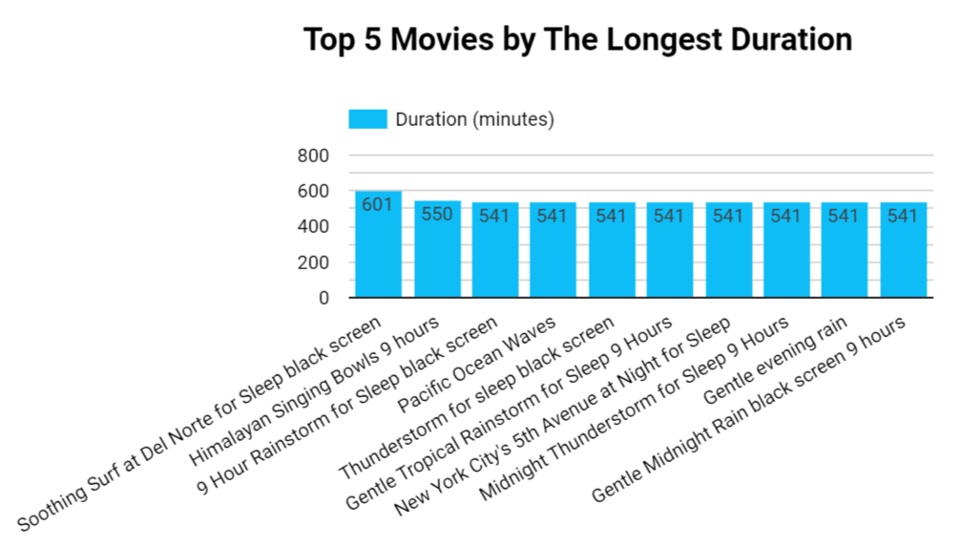
From the chart, we can see that movies from Amazon that has the longest duration in minutes is ‘Soothing Surf at Del Norte for Sleep Black Screen’ with the duration of 601 minutes, followed by Himalayan Singing Bowls 9 hours and etc.

Slide 20
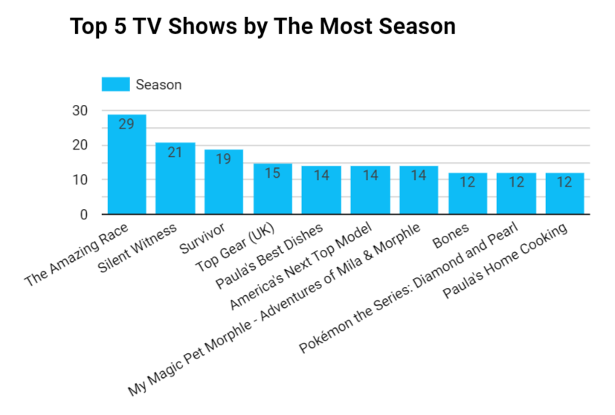
From the chart, we can see that TV show from Amazon that has the most Season is The Amazing Race with 29 season, followed by Silent Witness and etc.

Slide 21
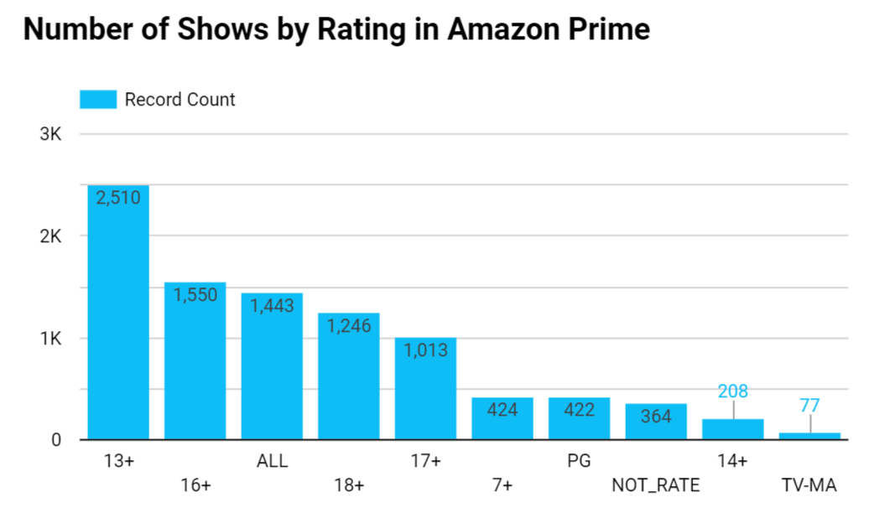
From the chart, we can see that most of titles of TV Show or movies in Amazon Prime have a rating of 13+ that is 2,510 titles. While the fewest is the TV-MA rating, 77 titles.

Slide 22
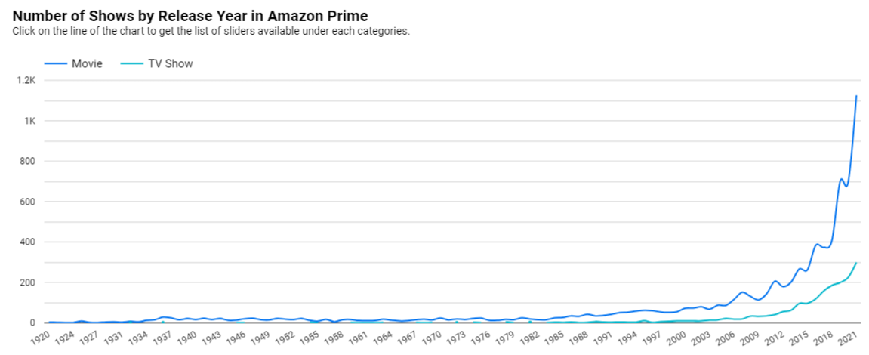
From the chart, we can see that it’s trend of movies and TV shows release year that was added in Amazon. The number of show by release year at movie have a significant increase start from 2019. While the TV show increase slowly year by year.

Slide 23
For full dashboard, kindly check on here

